Slide 1
OnePose: A Deep Dive into the Method From Video Scan to 6D Pose in Real-Time
Raghavendra Huliyurdurga Mallesha
Akhilesh Katari
10/09/2025

Slide 2
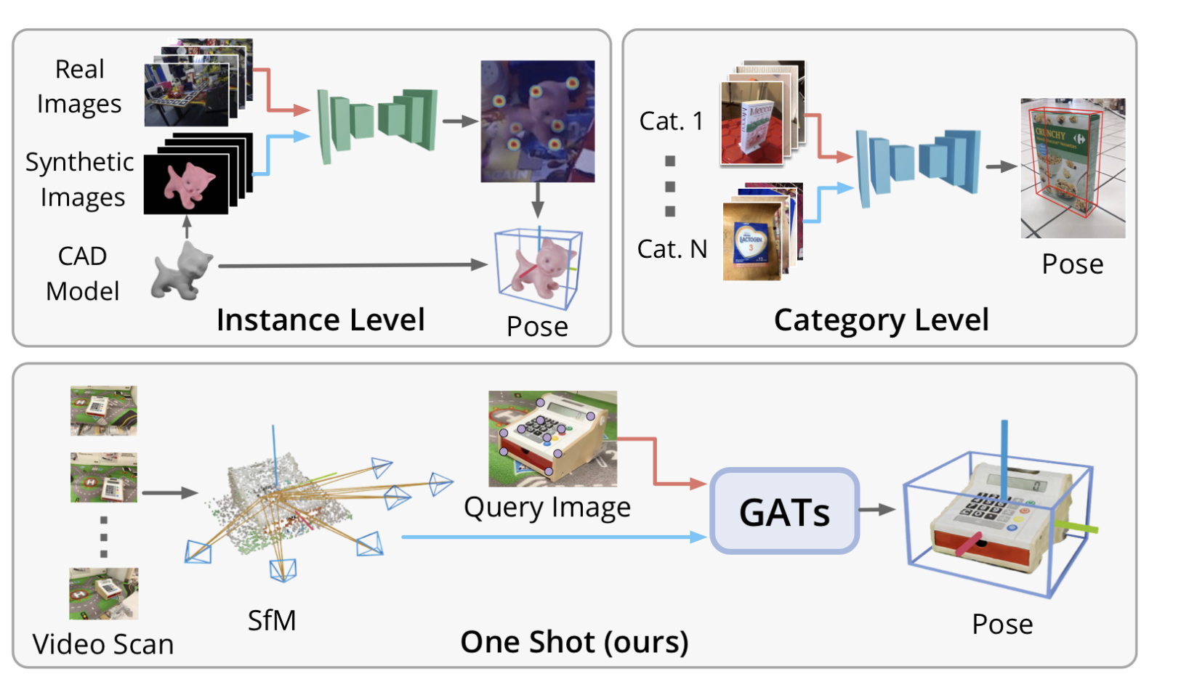
The Core Idea - A New Perspective
This idea is executed in a two-phase pipeline:
One-time offline ‘Mapping’ phase to build the map
Real-time online 'Localization' phase to find the pose.
9/12/22
Footer Space
(Slide No.) 2

Slide 3
Phase 1 - Mapping
It starts with a simple RGB video scan of the object.
A neural network called SuperPoint analyzes each frame to find stable 2D keypoints.
Then, SuperGlue, another network, intelligently matches these same landmarks across all the different video frames.
Finally, these robust 2D matches are fed into a Structure from Motion tool called COLMAP.
It uses the matches to triangulate and build a sparse 3D point cloud.
This point cloud becomes our lightweight, data-driven replacement for a CAD model."
9/12/22
Footer Space
(Slide No.) 3

Slide 4
Phase 2 - Localization
First, just like before, we use SuperPoint to extract 2D keypoints from the new image.
Now for the key innovation: 2D-to-3D matching. The authors designed a novel Graph Attention Network (GAT) for this.
It takes all the 2D points from our image and the 3D points from our model and treats them as nodes in a graph.
Using attention, the network looks at the entire context to figure out the most probable matches.
This is far more robust than simple feature comparison and is the technical core of the paper.
9/12/22
Footer Space
(Slide No.) 4

Slide 5
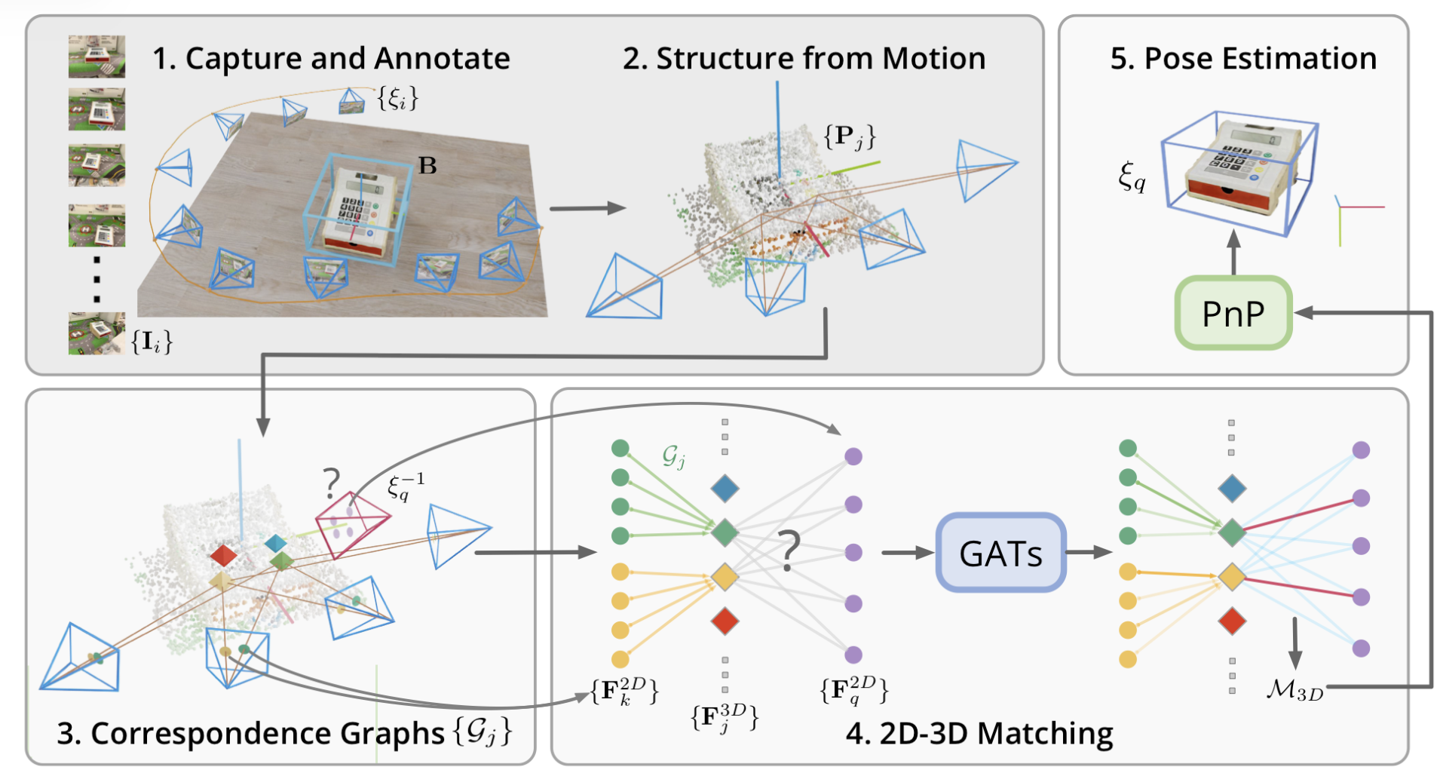
9/12/22
Footer Space
(Slide No.) 5

Slide 6
The Final Step - From Matches to Pose
The matches are passed to a classic algorithm called a PnP (Perspective-n-Point) solver.
PnP is extremely efficient and uses these correspondences to mathematically calculate the camera's exact 6D pose relative to the 3D point cloud. This pose is our final answer.
The efficiency of this entire localization pipeline is what enables real-time performance
9/12/22
Footer Space
(Slide No.) 6

Slide 7
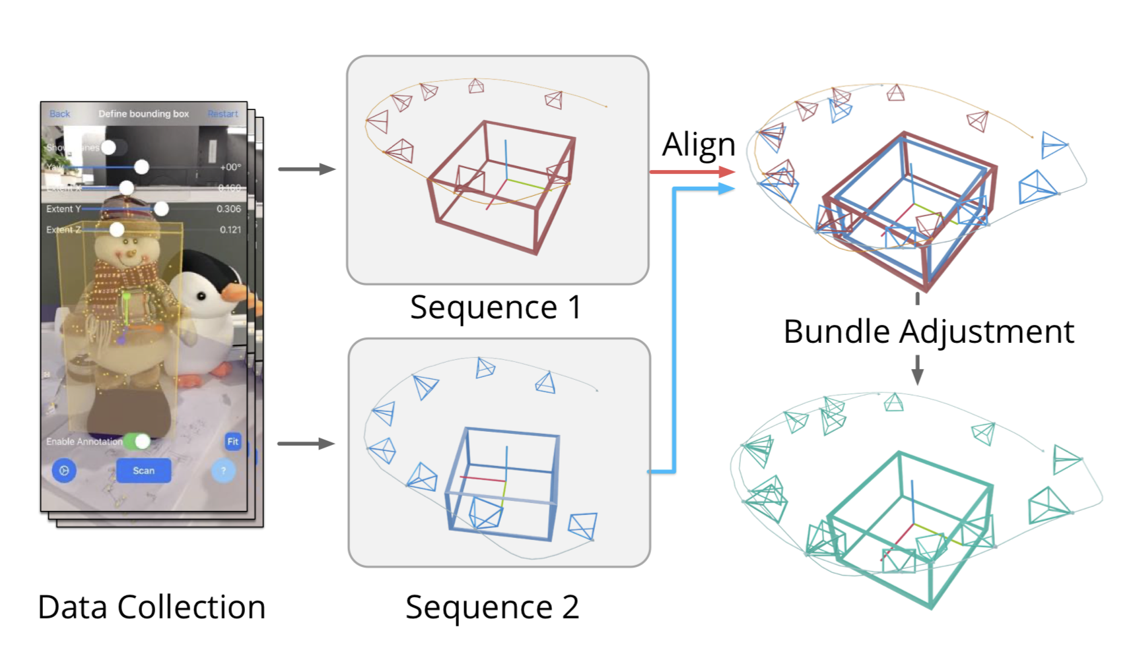
Summary of the Architecture
For any new image, we use SuperPoint and their novel GAT to find 2D-to-3D matches, which a PnP solver uses to compute the 6D pose.
9/12/22
Footer Space
(Slide No.) 7

Slide 8
Paper’s Contributions
• A New "One-Shot" Problem Formulation: The paper formally defines and tackles the one-shot 6D pose estimation problem. This addresses the critical challenge of scalability by creating a framework where a model can handle a new object after seeing it just once in a brief video, completely removing the need for prior CAD models or extensive, category-specific training.
• Novel Graph Attention Network for 2D-to-3D Matching: The primary technical innovation is the design of a specialized Graph Attention Network (GAT). This network directly and efficiently finds correspondences between 2D keypoints in a query image and 3D points in a sparse SfM model, solving a key bottleneck that made previous visual localization methods too slow or unreliable for this task.
• An End-to-End, Real-Time Capable Pipeline: The paper contributes a complete and practical system. It successfully integrates best-in-class generic components (SuperPoint, SuperGlue, COLMAP) for model building with their novel GAT for localization, resulting in a cohesive, end-to-end pipeline that is efficient enough for real-time applications.
• A New Large-Scale Benchmark Dataset: To validate their approach and encourage future research, the authors created and publicly released the OnePose dataset. This dataset contains hundreds of video sequences for 150 diverse real-world objects, providing a much-needed benchmark for evaluating CAD-model-free, one-shot pose estimation methods.
9/12/22
Footer Space
(Slide No.) 8

